Slide 1
Welcome!
Town of Weaverville Pickleball Information Session
Presented by Sarah Myers, Recreation Coordinator/Community Center Manager
Email: Smyers@WeavervilleNC.org

Slide 2
The Plan
Lake Louise Complex Rules
Pickleball Schedule
General Schematic and Information
Free Monthly Clinics
Resources for Learning
Questions from You
Notes:
When the construction of the Complex began, the Town recruited an ad hov Committee to help inform the rules and operations of the Recreation Complex as a whole. Over time, we also dove in to the intricacies and needs of Pickleball specifically. As you’ll see, tonight we will also talk about the Complex as a whole, and pickleball as a specific component.

Slide 3
Lake Louise complex Rules
Important Notes:
1. Operating schedule is similar to all other Weaverville Parks –
Sunrise to Sunset. No lighting is allowed.
2. No private lessons permitted
3. In an emergency, CALL 911, not the number listed on the signs.
That number is to be used if the gates are locked when they shouldn’t be, or if there is an issue with a court.
Notes:
These signs are posted on every fence up at the Recreation Complex, they are also available on our website, social media, and I’m happy to share a copy if anyone would like their own.
These rules were created in partnership with an ad hoc committee of Weaverville Pickleball players. We convened this committee four times to discuss the operations and structure of this recreation complex, and specifically the Pickleball courts. A few things I want to call attention to:

Slide 4
Pickleball COURTS
Important Notes:
Open Play schedule is a set number of hours (4)
These hours vary based on the season
2. You can show up with a group of friends to Open Play, but you will all be rotating in with other folks. Open play is a great way to learn and meet people.
3. When it is FCFS – a 1 hour playtime limit for any individual group
4. Courts close at 1PM on Wednesdays
Notes:
These signs are also posted on the fences at the Recreation Complex, and available on our website, social media, and the e-News. Specific things to mention:

Slide 5
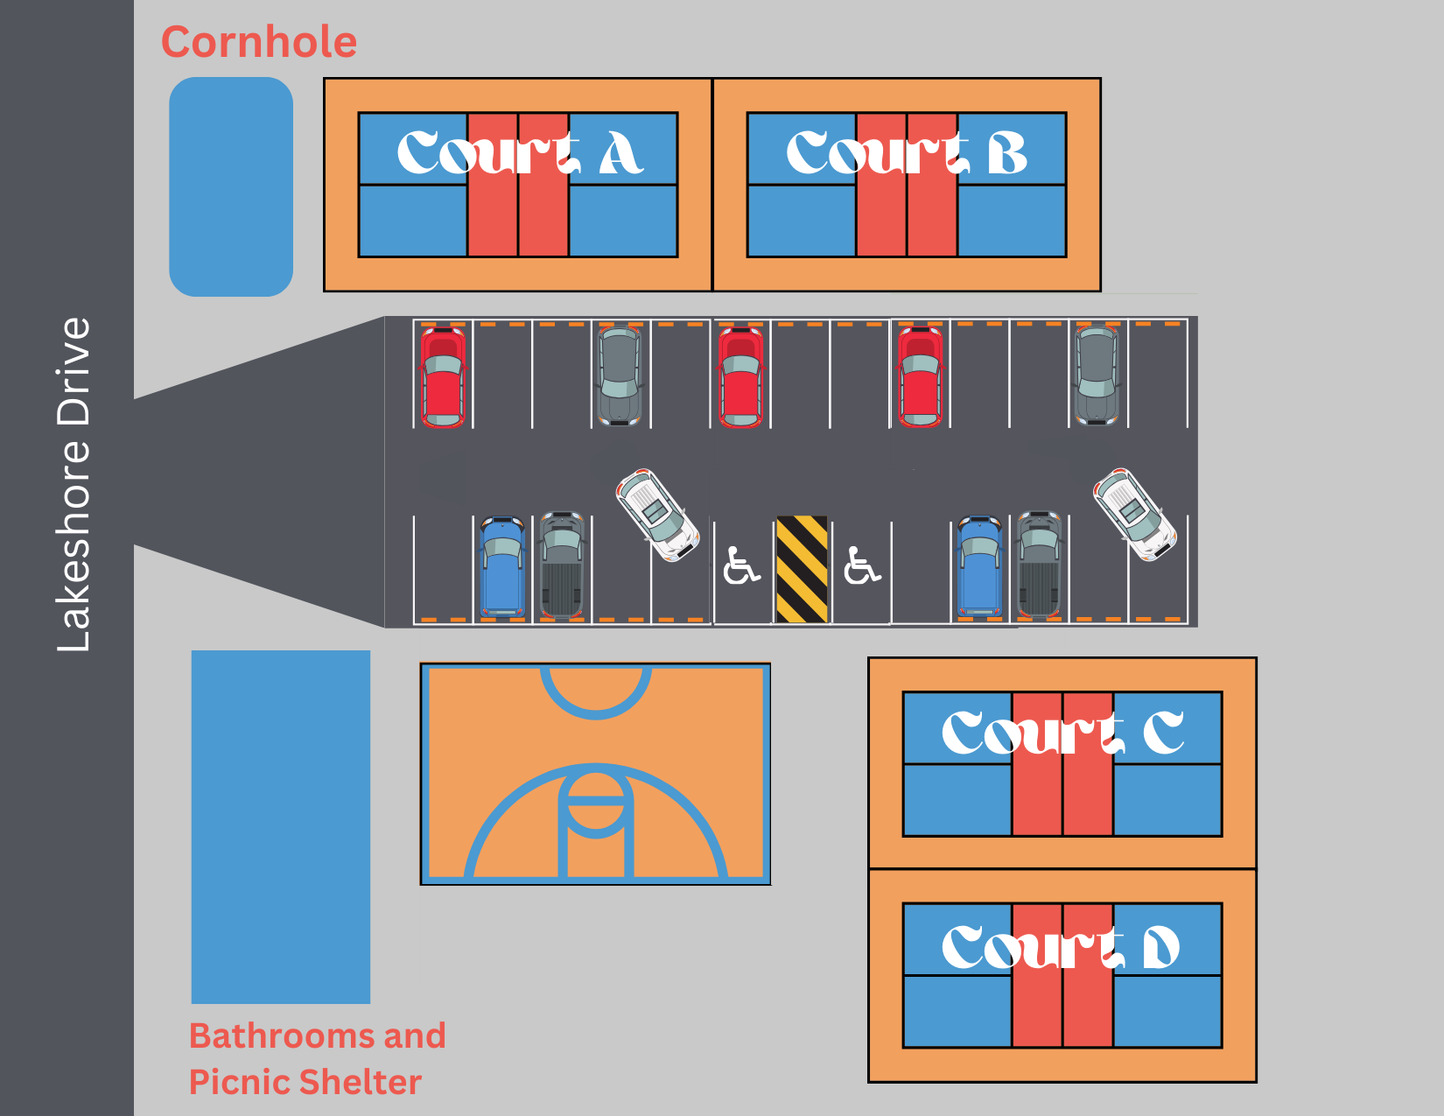
Schematic
PHASE 1:
PHASE 2:
Notes:
This is a schematic of the Complex. You’ll note that Phase 1 is the opening of all of the Courts – Phase 2 will include the coating of the pickleball courts, bathrooms, a picnic shelter, and cornhole.

Slide 6
HOT TOPICs
First Aid Kit is available at the Community Center, during CC operating hours
Until the bathrooms are complete at the Complex, a porta-john is available for use
Bathrooms at Community Center are available during operating hours: M-F 8:30-5, and bathrooms at the Lake Louise Playground are open sunrise-sunset
Lost and Found – none on site, feel free to bring items to the Community Center M-F 8:30-5
26 Parking Spots and a Bike Rack are available at the Complex, there is additional parking at the Community Center and the Lake
Parking at the Community Center may be restricted for private events, we will place signs when this happens
As you start playing on the paved, striped Courts; you may notice some imperfections. These will be addressed/fixed in the Spring when we coat and paint the Courts
OPENING DATE - Courts will be open for play February 3rd

Slide 7
Free MonthLy Clinics
Clinics will be the last Saturday of each month, March to October
March 30th at 10am
April 27th at 10am
May 25th at 10am
June 29th at 9am
July 27th at 9am
August 31st at 9am
September 28th at 9am
October 26th at 10am
Sign up Information:
Clinics will be limited to 12 people
Signups will be posted one month before each event, notifications will be shared on the Town website, E-News, and social channels
Signups will be first come, first serve, a waiver will be required
Notes:
We are partnering with our local Pickleball Pros to offer free clinics. These will be instructed by certified instructors, and supported by trained and vetted volunteers. The clinics will occupy two courts for 90 minutes, at the times above. This information will be shared on the Town website, Town social media, and we will post signs about the clinic and closure one week ahead of time. The monthly pickleball sign up notification will be up on the Town website, social media, E-Newsletter, and WCCHL newsletter.

Slide 8
Resources for Learning More
USA Pickleball Association website: usapickleball.org
Youtube videos
The Courts during Open Play
Contact me: SMyers@WeavervilleNC.org
To ensure that you’re aware of updates, closures, and clinics; visit WeavervilleNC.org and sign up for the Town E-Newsletter

