Slide 1

Town Council Workshop – September 14, 2026
Merchants Alley Overview and Preliminary Concepts
Florida Avenue Preliminary Concept
Staff Recommendation
Public Input
Town Council Preliminary Discussion & Direction

Slide 2
Opening Remarks
No decisions have been made and none are expected at tonight’s meeting
All options will require further study, detailed planning, notice & education, new signage, and street improvements (striping) before implementation
Looking for input from Town Council on which options to more fully explore
Businesses have been included in the Merchants Alley conversation and their input is being gathered; continued discussion is needed
Town Hall has been busy last week and today with many businesses and individuals reviewing materials and noting which preliminary options they prefer
Written and emailed comments have been provided and have been forwarded to Town Council and printed out
Florida Avenue was recently added to the discussion since it is closely related to Merchants Alley; public conversation on this possibility is new and will be ongoing
Public input will be provided at tonight’s meeting
There will be more public input and public hearing once the options for further study are identified by Town Council
Town Council and Town staff appreciates preliminary public input on these matters, with more expected to come later
Public Comment Rules will apply

Slide 3
Merchants Alley – General Comments
Merchants Alley is a 20-foot-wide public street that offers both southbound and northbound travel
Parking in the travel way has increased over the years
Town Code prohibits parking in a travel way (Code 28-95)
Parking in the travel way has resulted in:
  Damage to Town vehicles
  Impaired emergency access
  Disrupted sanitation routes
  Difficulties for public to navigate the streets
  Citizen complaints
Minimum travel way width is 8 feet
Travel way for an emergency vehicle is as much as 12 feet
It appears that 3 businesses have enough space on their property for parallel parking spaces on their private property (outside of the Town street)
Preliminary concepts were developed at the request of Town Council on July 13

Slide 4
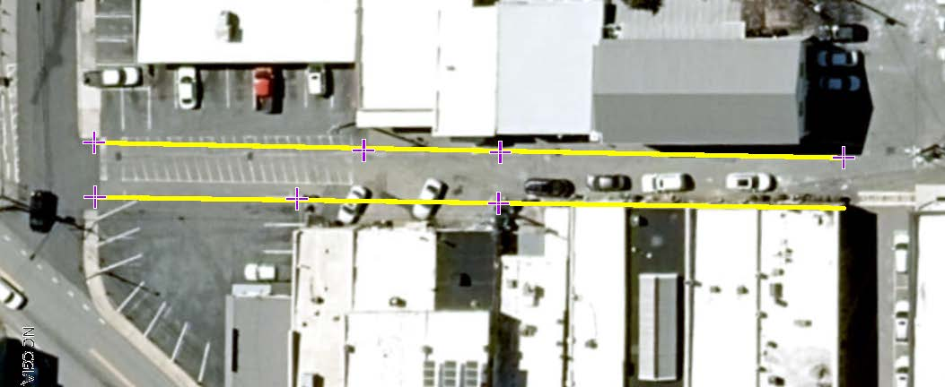
Central Avenue
Merchants Alley
Florida Avenue
Merrimon Avenue
Merchants Alley is a public street owned and maintained by the Town. This public street is 20 feet wide and is a travel way open to the public. Parking within the travel way has increased and obstructs emergency access, sanitation services, and through traffic. Town Council is considering a reconfiguration of Merchants Alley to address this problem

Slide 5
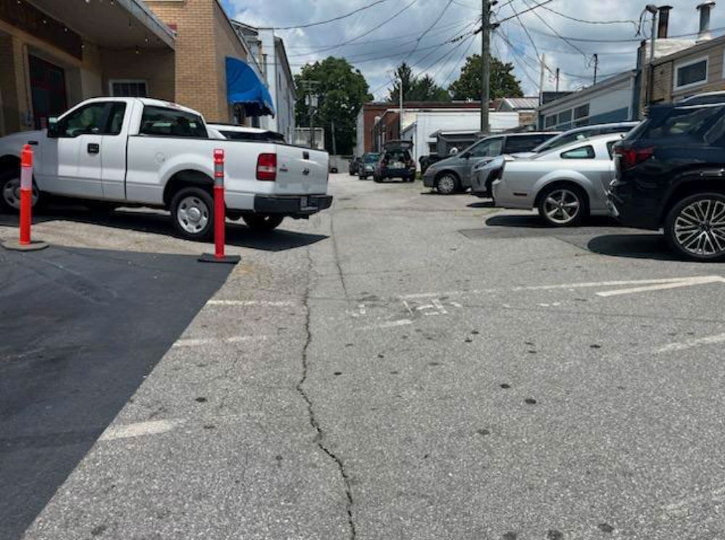
Recent photo showing parked cars in the travel way.

Slide 6
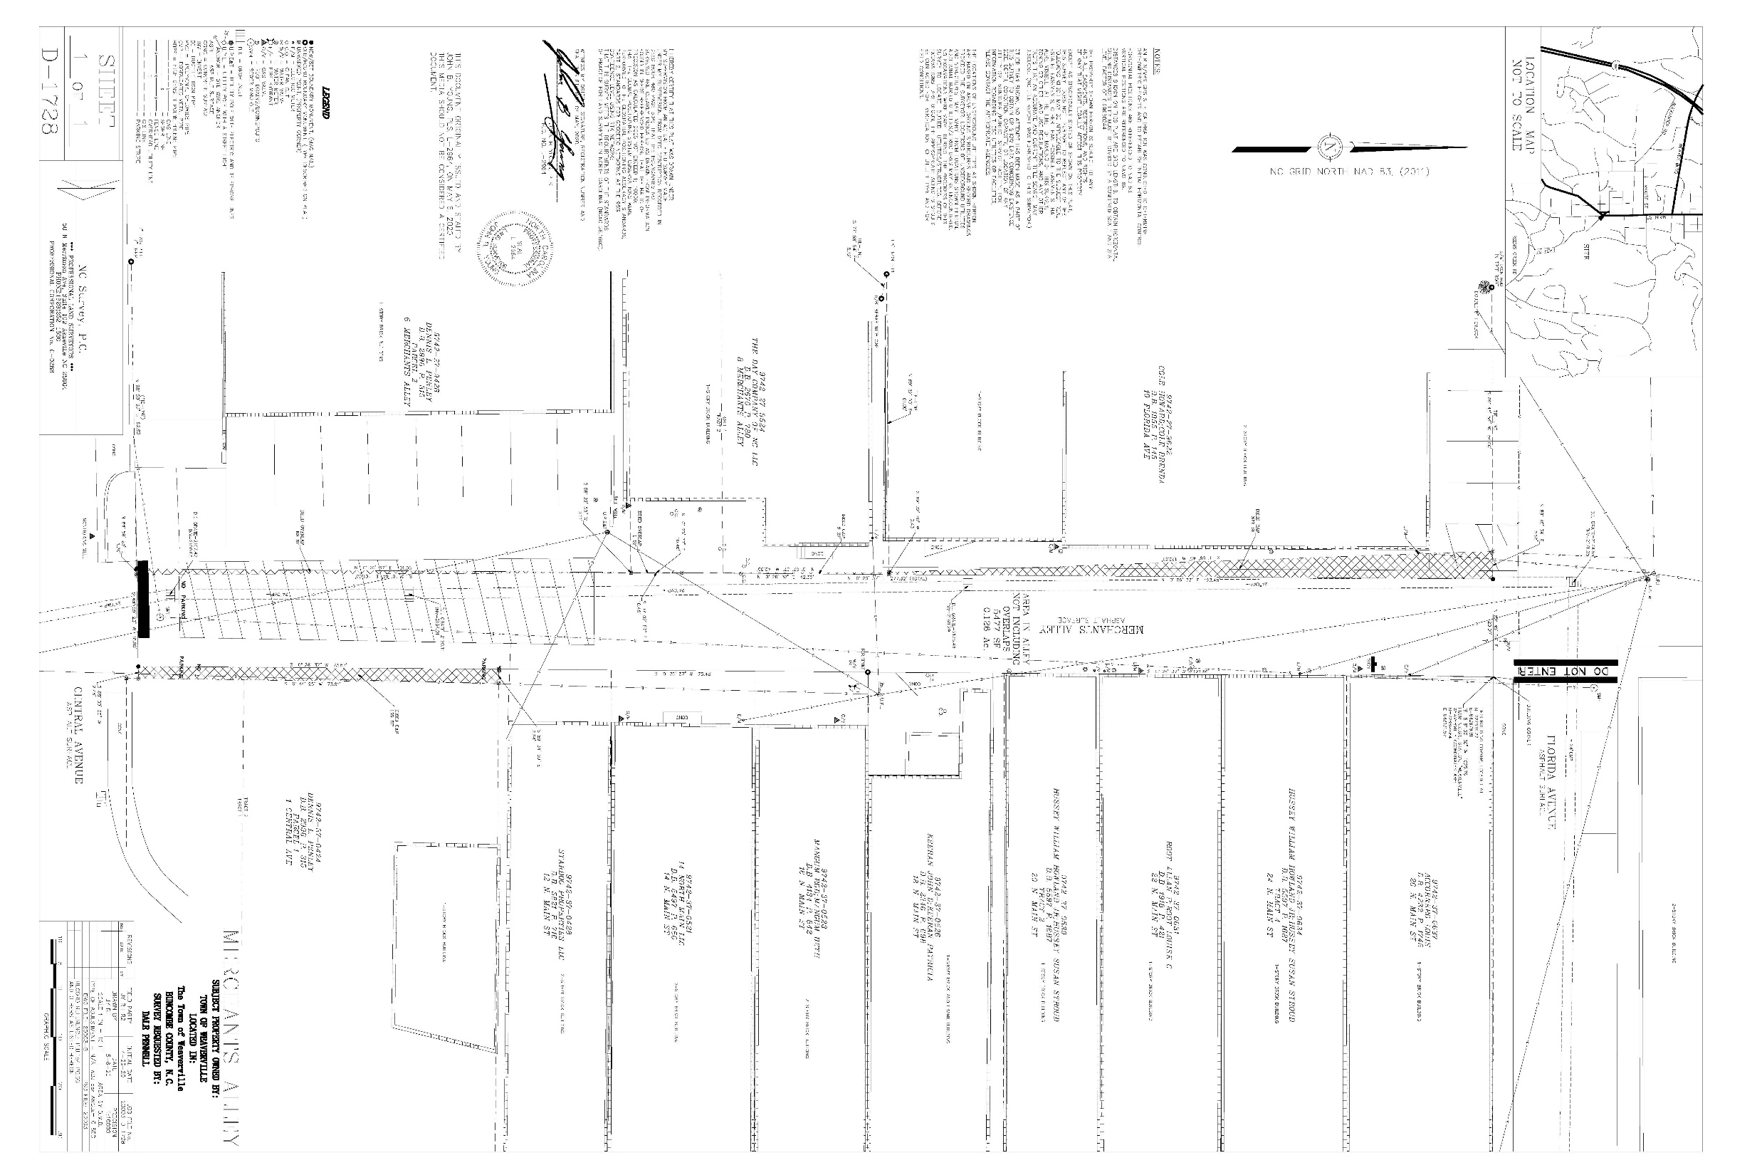
2020 Survey

Slide 7
Merchants Alley – Preliminary Concept
Loading/Unloading and Dedicated Fire Lane
Allows temporary parking of cars and delivery trucks in the northbound lane
Leaves southbound lane open as a dedicated fire lane and for sanitation route
Through traffic is eliminated
Delivery trucks can access both northbound and southbound with temporary parking in northbound lane
Dedicated loading/unloading lane could provide better management of garbage with dumpsters
Limited public parking spaces for general public in northbound lane could be considered if not in conflict with loading/unloading areas or potential dumpster areas
Best option for safety considerations
Good option for loading/unloading
Option recommended by staff

Slide 8
FIRE LANE
LOADING/UNLOADING - NO THRU TRAFFIC & NO PARKING
1
2
3
Optional parking spaces on private property
Optional 1-block closure of Florida Avenue
This reconfiguration focuses on the loading and unloading needs of the area businesses in a way that preserves emergency access and sanitation services. In general, through-traffic and public parking within Merchants Alley are eliminated under this option.
Preliminary Concept
Loading/Unloading Area and Fire Lane
Not to Scale

Slide 9
Merchants Alley – Preliminary Concept
2-Way with Loading/Unloading
Allows temporary parking of cars and delivery trucks in the northbound lane
Leaves southbound lane open for emergency access and sanitation route
Allows through traffic from both southbound and northbound directions
Delivery trucks can access businesses northbound with temporary parking in marked space in northbound lane
Northbound traffic that encounters stopped vehicles in marked loading/unloading areas can pass when safe to do so (traffic is typically light and speeds low)
No public parking spaces for the general public – only temporary parking in the loading/unloading area
Good option for safety consideration
Good option for loading/unloading

Slide 10
TEMPORARY LOADING/UNLOADING
1
2
3
Optional parking spaces on private property
Optional 1-block closure of Florida Avenue
Bi-directional loading and unloading is allowed in the northbound lane. Public parking within Merchants Alley is eliminated under this option.
Preliminary Concept
2-Way Traffic with Temporary Loading/Unloading
Not to Scale

Slide 11
Merchants Alley – Preliminary Concept
1-Way Southbound with Loading/Unloading
Allows temporary parking of cars and delivery trucks in the northbound lane
Leaves southbound lane open for emergency access and sanitation route
Allows through traffic southbound only
Delivery trucks can access both northbound and southbound with temporary parking in dedicated loading/unloading lane
Dedicated loading/unloading lane could provide better management of garbage with dumpsters
Limited public parking spaces for general public in loading/unloading lane could be considered if not in conflict with loading/unloading areas or potential dumpster areas
Not a good option for safety because of likelihood of people driving the wrong way on the one-way (happens routinely on Florida Avenue)
Good option for loading/unloading

Slide 12
LOADING/UNLOADING ZONE
1
2
3
Optional parking spaces on private property
Optional 1-block closure of Florida Avenue
Bi-directional loading and unloading is allowed in the northbound lane. Public parking within Merchants Alley is eliminated under this option.
Preliminary Concept
1-Way Traffic (Southbound) with Loading/Unloading
Not to Scale

Slide 13
Merchants Alley – Preliminary Concept
1-Way Northbound with Loading/Unloading
Allows temporary parking of cars and delivery trucks in the southbound lane
Leaves northbound lane open for emergency access and sanitation route
Allows through traffic northbound only
Delivery trucks can access both northbound and southbound with temporary parking in dedicated loading/unloading lane
Dedicated loading/unloading lane could provide better management of garbage with dumpsters
Limited public parking spaces for general public in loading/unloading lane could be considered if not in conflict with loading/unloading areas or potential dumpster areas
Not a good option for safety because of likelihood of people driving the wrong way on the one-way (happens routinely on Florida Avenue)
Not a good option if Florida Avenue has eastbound traffic (creates a dead-end into two 1-way traffic lanes)
Good option for loading/unloading

Slide 14
LOADING/UNLOADING ZONE
1
2
3
Optional parking spaces on private property
Optional 1-block closure of Florida Avenue
Bi-directional loading and unloading is allowed in the southbound lane. Public parking within Merchants Alley is eliminated under this option. For this option to be workable the two-traffic on Florida Avenue will have to be evaluated before implementation. Eastbound traffic on Florida Avenue will deadend unless further reconfigurations are considered.
Preliminary Concept
1-Way Traffic (Northbound) with Loading/Unloading
Not to Scale

Slide 15
Florida Avenue – Possibility
Florida Avenue is a Town street that extends from Main Street to Alabama Avenue
The block from Main Street to Merchants Alley is 1-way westbound; the remainder is 2-way
A possible Florida Avenue reconfiguration has been discussed several times by Town Council over the last 10 years.
Since it is closely tied to Merchants Alley that possibility and preliminary concept was presented as well.
Partial closure of Florida Avenue, on the 1-way section between Main Street and Merchants Alley has been considered in order to provide an area for outdoor dining
If implemented the outdoor dining area would be furnished and maintained by the Town and open to the general public; not dedicated to just the adjoining businesses
Would provide an alternative to so many tables and chairs on the Main Street sidewalks that obstruct access by pedestrians, wheelchairs, strollers, etc.
The 1-way portion of Florida Avenue consistently has traffic traveling the wrong way; a variety of signage has been tried
5 businesses would be directly impacted
Strategic Plan includes increasing outdoor dining options
ADA requires sidewalks to be clear of obstructions

Slide 16
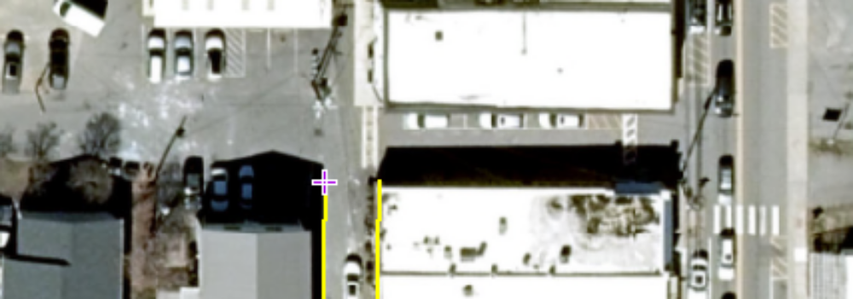
Outdoor Dining and possible Social District
Changes to Florida Avenue between Main Street and Merchants Alley could be considered along with a reconfiguration of Merchants Alley. A one-block closure of Florida Avenue would allow the creation of an outdoor dining area with possible social district.
This is a preliminary concept only and will need to be fully planned if implementation is desired by Town Council.
Preliminary Concept
Outdoor Dining/Social District
Not to Scale

Slide 17
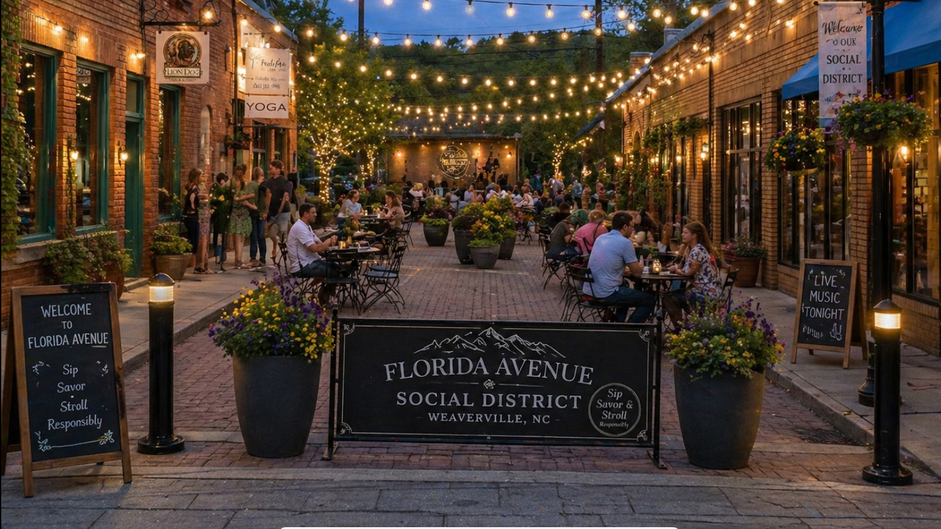

Slide 18
Public Street – Legal Authority
The Town has an obligation to keep public streets open for travel and free from unnecessary obstructions (160A-296 (a)(2))
The Town cannot let a known dangerous condition continue (caselaw)
The Town can prohibit, regulate, divert, control, and limit pedestrian or vehicular traffic upon its public streets (160A-296, 160A-300)
The Town can close any street or alley either permanently or temporarily (160A-296(a)(4))
Specified procedures for permanently closing streets and alleys (160A-299)
  Public notice:
    Mailed notice to those directly affected
    Signs in the area
    Publication in the newspaper
  Town Council must find that the closure is not contrary to the public interest and that no one who owns property in the vicinity of the street will be deprived of “reasonable means of ingress and egress” to that property after the street is closed

Slide 19
Staff Recommendations
Merchants Alley must be addressed
Loading/Unloading Area with Dedicated Fire Lane Option for Merchants Alley is recommended
Town Council Direction on which Merchants Alley options to develop more fully
Town Council Direction on whether to study closure of Florida Avenue

Slide 20
FIRE LANE
LOADING/UNLOADING - NO THRU TRAFFIC & NO PARKING
1
2
3
Optional parking spaces on private property
Optional 1-block closure of Florida Avenue
This reconfiguration focuses on the loading and unloading needs of the area businesses in a way that preserves emergency access and sanitation services. In general, through-traffic and public parking within Merchants Alley are eliminated under this option.
Preliminary Concept
Loading/Unloading Area and Fire Lane
Not to Scale

Slide 21
Public Input
Town Hall Lobby Results
Written Comments
9/14/2026 Meeting – Public Input
Additional Public Input will be offered as options develop

Slide 22
Town Council Preliminary Discussion and Direction
Town Council not yet ready to make any decisions
Both discussion are in preliminary phases and more notice and public input will be provided
Task Force with businesses and Town staff represented to be formed for further study and to try to find a mutually agreeable solution
Town staff to re-engage with area churches regarding downtown employee parking and to ensure safe access to those parking opportunities
Town staff to create a more complete concept of the Florida Avenue pedestrian plaza, including a more accurate rendering, and to address business needs

